Slide 1
Final review

Slide 2
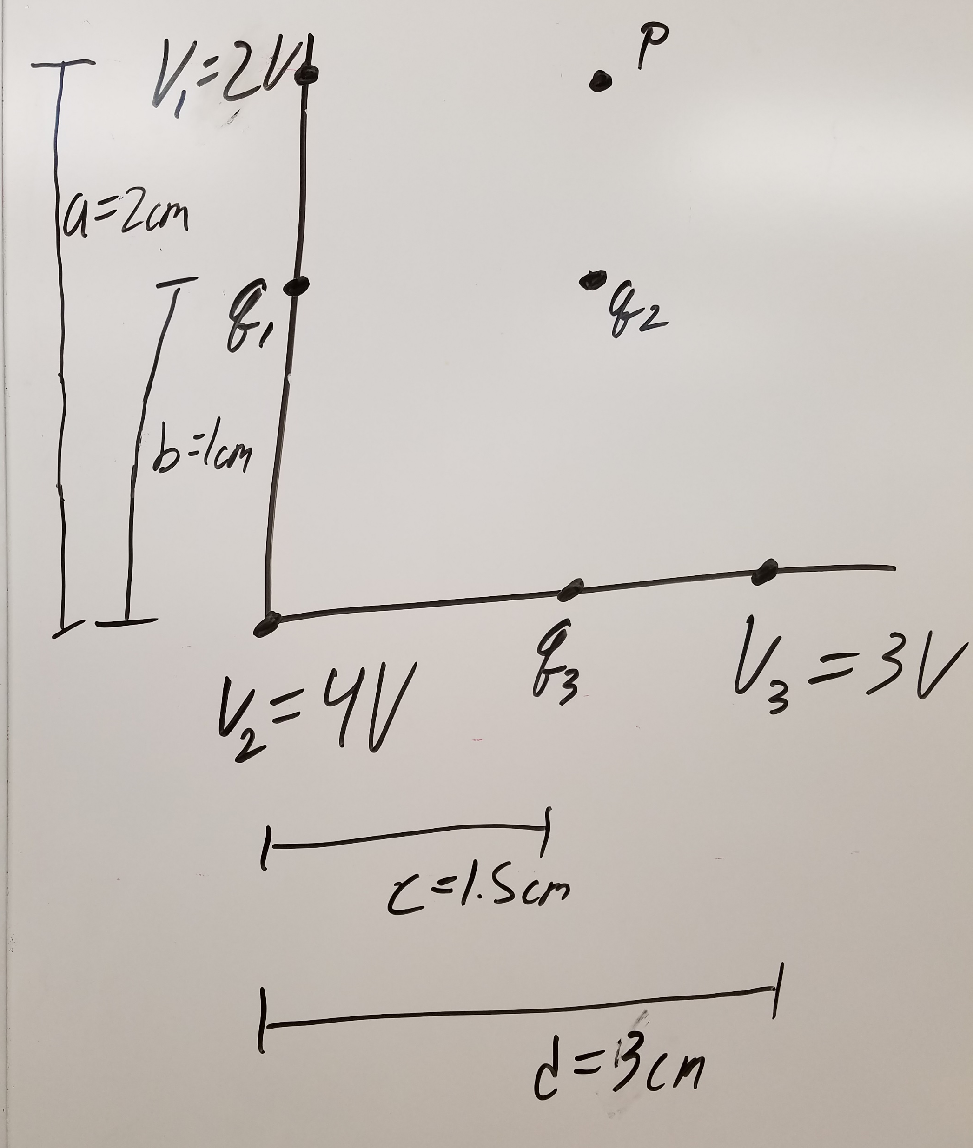
Chapters 21 & 23
Given the voltages at the three points as shown, find the values of the three charges. Then, find the net electric field at point P.

Slide 3
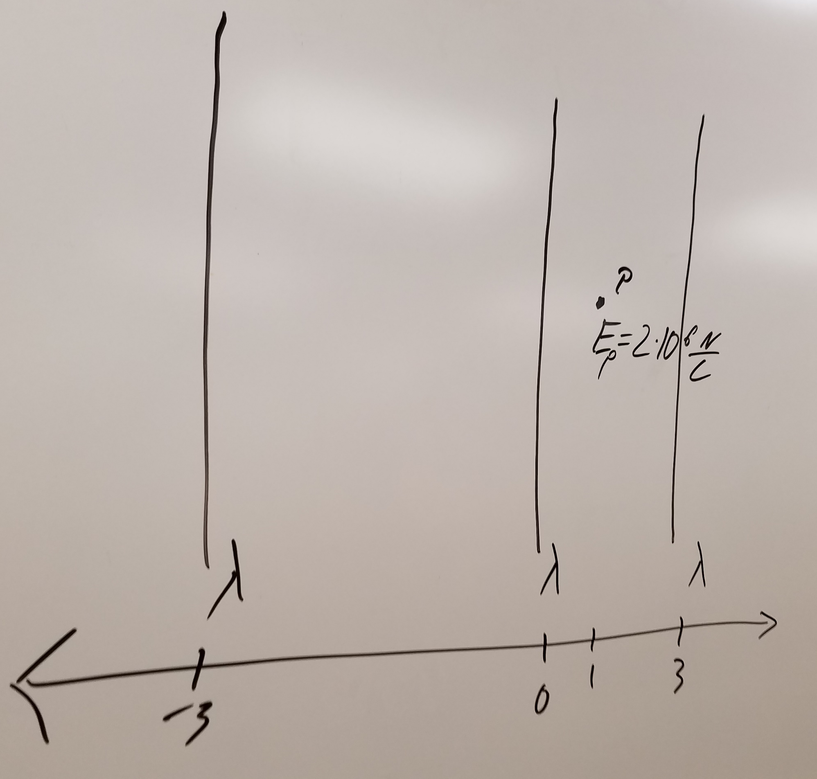
Chapter 22
Given three infinitely long wires with the same continuous charge distribution as shown and given the net electric field at P, find lambda.

Slide 4
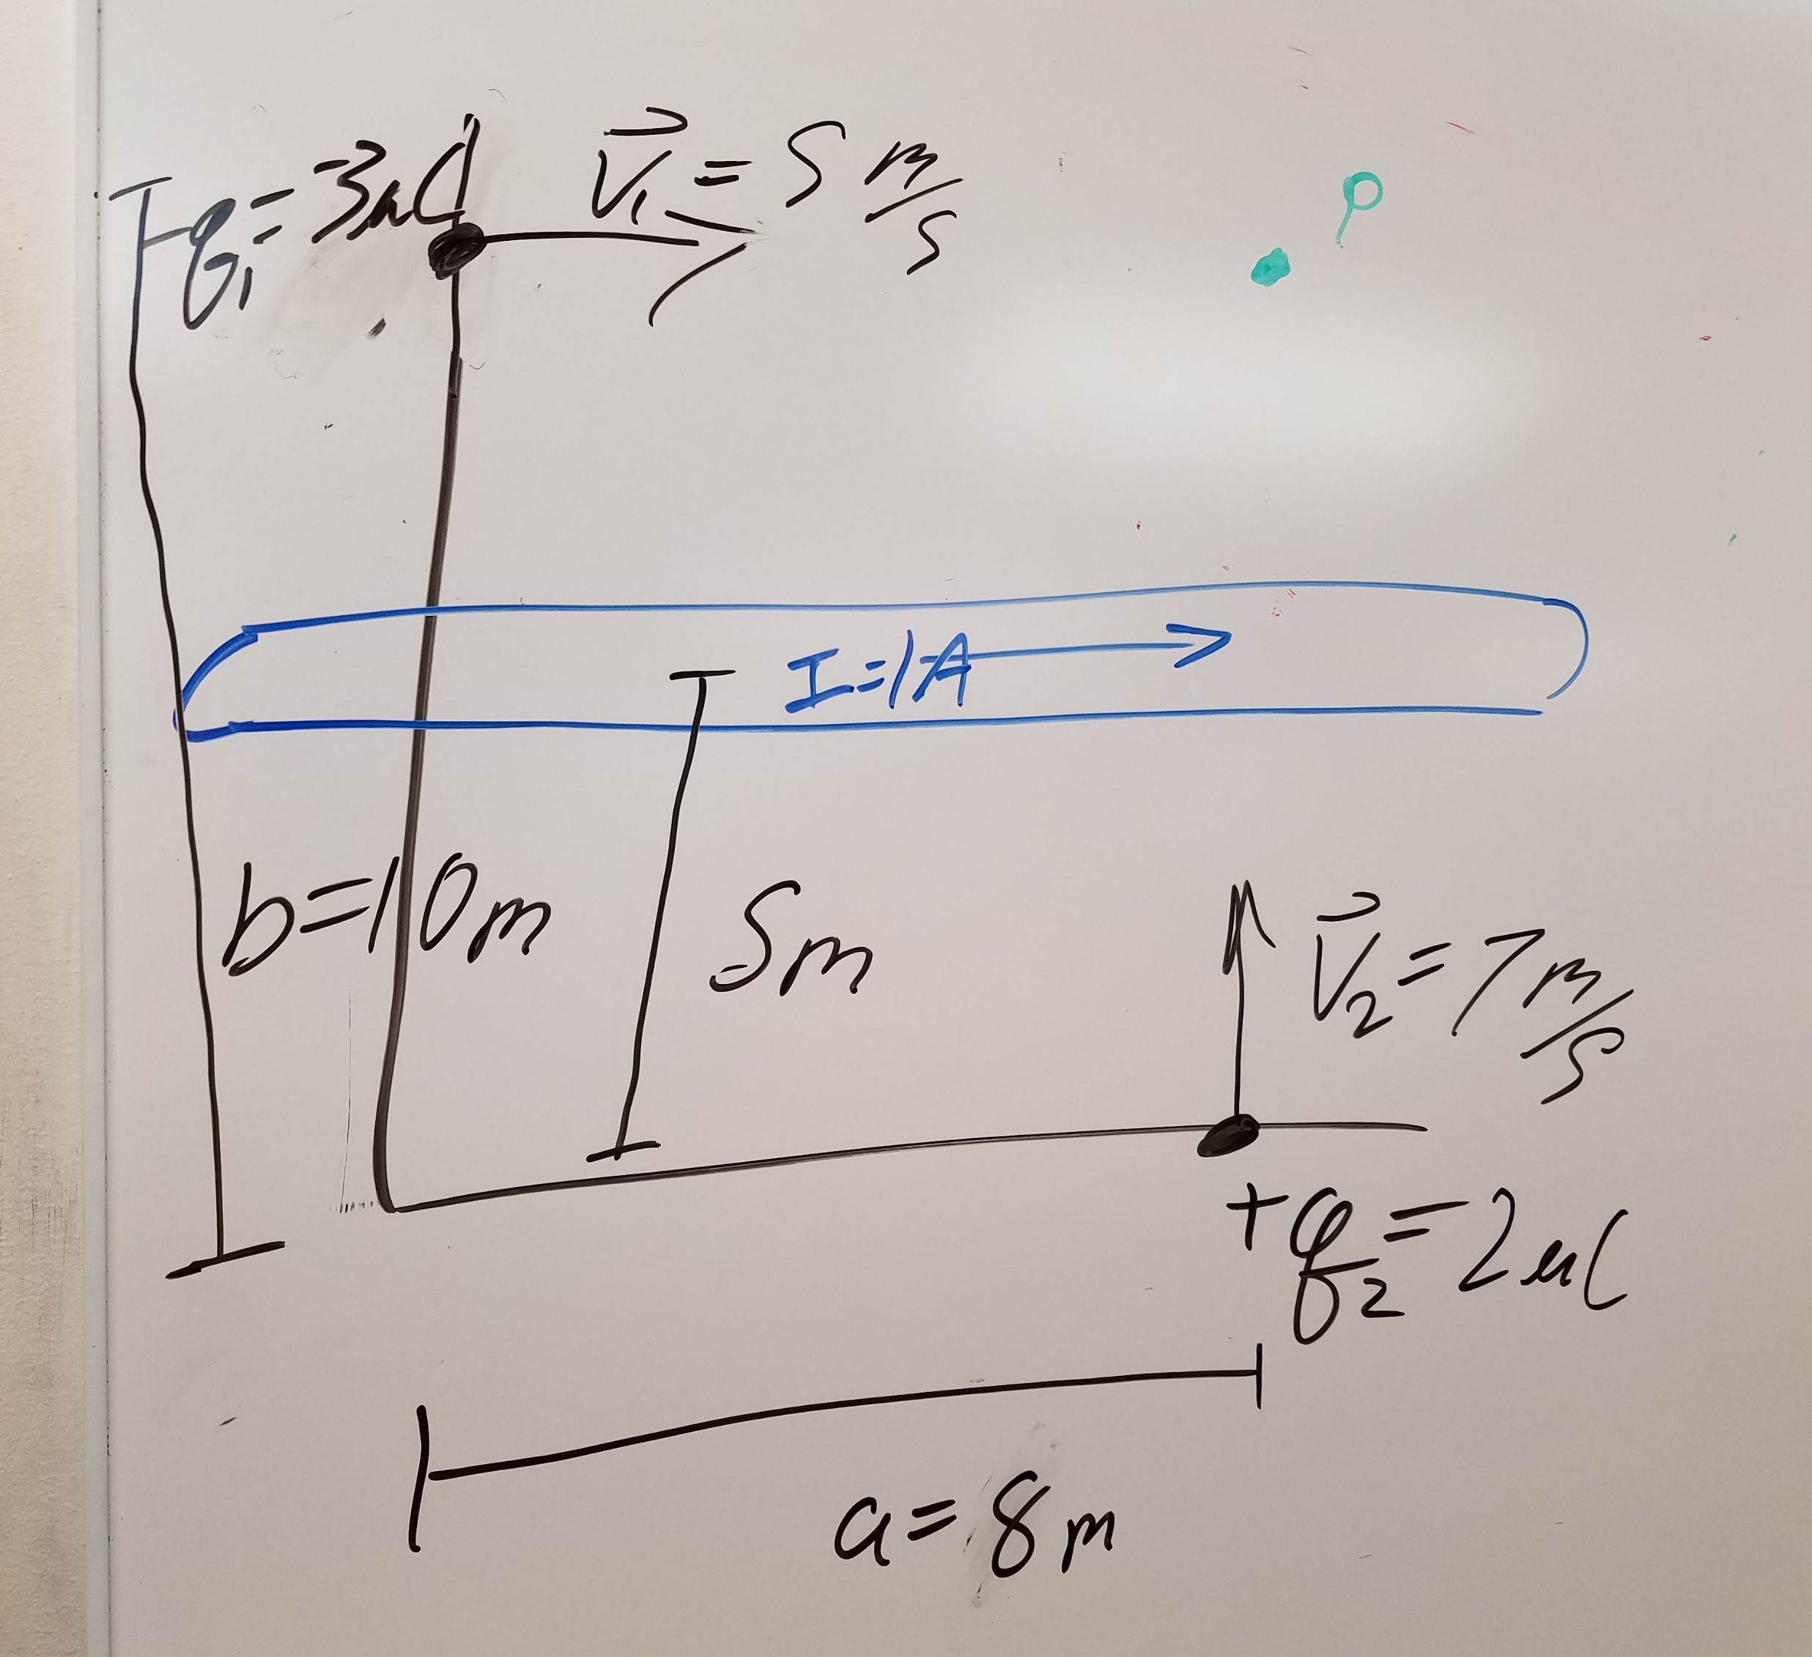
Chapters 27 & 28
Given 2 moving charges and an infinitely-long current-carrying wire as shown, find the magnetic field at point P, and find the force acting on the first charge.

Slide 5
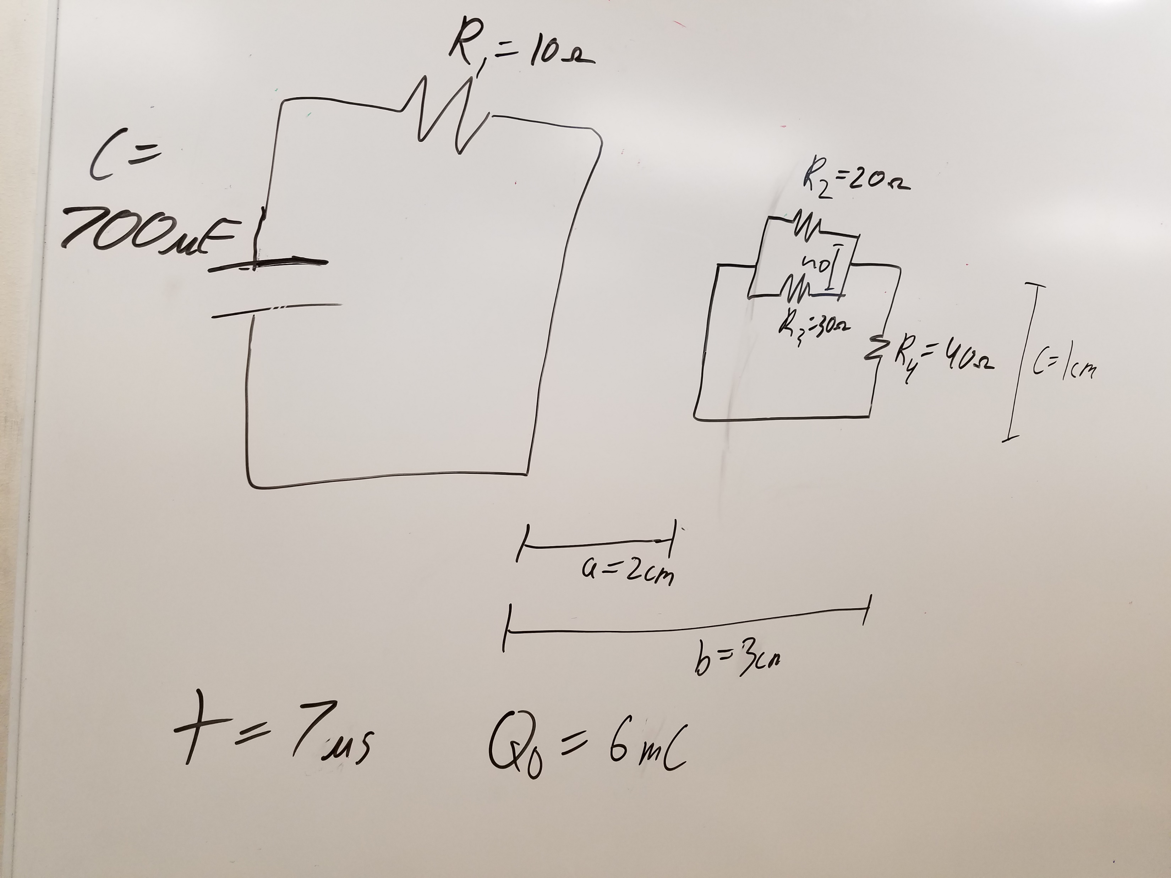
Chapters 26 & 29
Given the R-C and R circuits shown with an initial charge on the capacitor of Q0, and knowing that the switch is closed at time t=0, find the following at t1: (a) the current in the first circuit, (b) the magnetic flux through the second circuit, (c) the induced current in the second circuit, and (d) the voltage across R2.

